Slide 1
Statistical Model
Md. Nahiyan Uddin Lecturer, CSE

Slide 2
Discrete Distribution
Discrete random variables are used to describe random phenomena in which only integer values can occur.
We will learn -
Bernoulli trials and Bernoulli distribution
Binomial distribution
Poisson distribution

Slide 3
Bernoulli Trials and Bernoulli Distribution
Bernoulli Trials:
Consider an experiment consisting of n trials
Each can be a success or a failure
Let,
j be the experiment no. and Xj be the result of the j^{th} experiment
Xj = 1 if the j^{th} experiment is a success
Xj = 0 if the j^{th} experiment is a failure
The result probability of n Bernoulli trials where trails are independent:
p(x1,x2,…, xn) = p1(x1)p2(x2)… pn(xn)
For example: p(0,1,0) = p(0)p(1)p(0)

Slide 4
Bernoulli Trials and Bernoulli Distribution
The Bernoulli distribution (one trial):
Let, the probability of any trial being a success is p.
p(Xj=1) = p where j = 1,2,3…n
The probability of any trial being a failure is q = 1 – p. p(Xj=0) = q = 1 – p where j = 1,2,3…n
Now, The mean, E(Xj) = p
The variance, V(Xj) = p(1 –p)
= pq

Slide 5
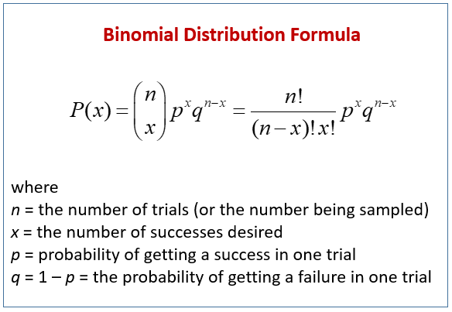
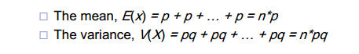
Binomial Distribution
Here we calculate the probability of having x number of successes in n number of trials.
A simplified version of Bernoulli Distribution

Slide 6
Example 1
What’s the probability that you flip exactly 3 heads in 5 coin tosses?

Slide 7
Example 1
Solution:
Here,
p = 50 % ( probability of getting a head is 50 % )
= 0.5
q = 1 – p
= 0.5
number of heads, x
number of total coin tosses, n = 5
We know,
probability of getting x heads, p(x) = ^{n}C_{x} .p^{x} .q^{n-x}
Now,
P(x = 3) = ⁵C₃ .p³ .q⁵⁻³
= ⁵C₃ .(0.5)³ .(0.5)⁵⁻³
= 0.3125 (Ans)

Slide 8
Example 2:
A production process manufactures computer chips on the average at 2% nonconforming. Every day, a random sample of size 50 is taken from the process. If the sample contains more than two nonconforming chips the process will be stopped. Compute the probability that the process is stopped by the sampling scheme.

Slide 9
Example 2:
Solution:
Here,
p = 2 %
= 0.02
q = 1 – p
= 0.98
number of conforming chips, x
number of total chips, n = 50
We know,
probability of x chips being conforming, p(x) = ^{n}C_{x} .p^{x} .q^{n-x}
Now,
P(x > 2) = 1 – { P(x=0) +P(x=1) + P(x=2) }
= 1 – {⁵⁰C₀ .p⁰ .q⁵⁰⁻⁰⁺ ⁵⁰C₁ .p¹ .q⁵⁰⁻¹ + ⁵⁰C₂ .p² .q^{n-2} }
= 1 - { ⁵⁰C₁ .(0.02)⁰ .(0.98)⁵⁰⁻⁰ + ⁵⁰C₁ .(0.02)¹ .(0.98)⁵⁰⁻¹ + ⁵⁰C₂ .(0.02)² .(0.98)^{n-2} }
= 0.078 (Ans)

Slide 10
Example 3:
A component has a 20% chance of being a dud. If five are selected from a large batch, what is the probability that more than one is a dud?

Slide 11
Example 3:
Solution:
Here,
p = 20 %
= 0.2
q = 1 – p
= 0.8
number of dud components, x
number of total sample components, n = 5
We know,
probability of x components being dud, p(x) = ^{n}C_{x} .p^{x} .q^{n-x}
Now,
P(x > 1) = 1 – {P(x=0) + P(x=1) +}
= 1 – { ⁵C₀ .p⁰ .q⁵⁻⁰ + ⁵C₁ .p¹ .q⁵⁻¹ }
= 1 - { ⁵C₀ .(0.2)⁰ .(0.8)⁵⁻⁰ + ⁵C₁ .(0.2)¹ .(0.8)⁵⁻¹ }
= 0.26 (Ans)

Slide 12
Example 4
As voters exit the polls, you ask a representative random sample of 6 voters if they voted for proposition. If the true percentage of voters who vote for the proposition is 55.1%, what is the probability that, in your sample, exactly 2 voted for the proposition and 4 did not?

Slide 13
Example 5
You are performing a cohort study. The probability of developing disease in the exposed group is 0.05 for the study duration. Suppose, you have sampled (randomly) 500 exposed people.
What’s the probability that at most 4 exposed people develop the disease?

Slide 14
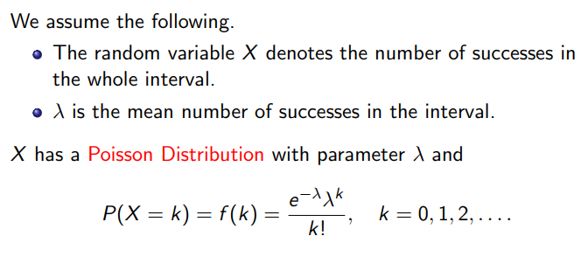
Poisson Distribution
A version of binomial distribution where we will be given an interval or range of an event or trial and an average number of occurrence. We will have to calculate the probability of given number of occurrence to happen.
Another Slide is provided on this topic. Have a look at that slide first to solve the following problems.

Slide 15
Example 1
A computer repair person is beeped each time there is a call for service. The average number of beeps per hour is 2.
The probability of three beeps in the next hour?
The probability of two or more beeps in a 1 hour period?

Slide 16
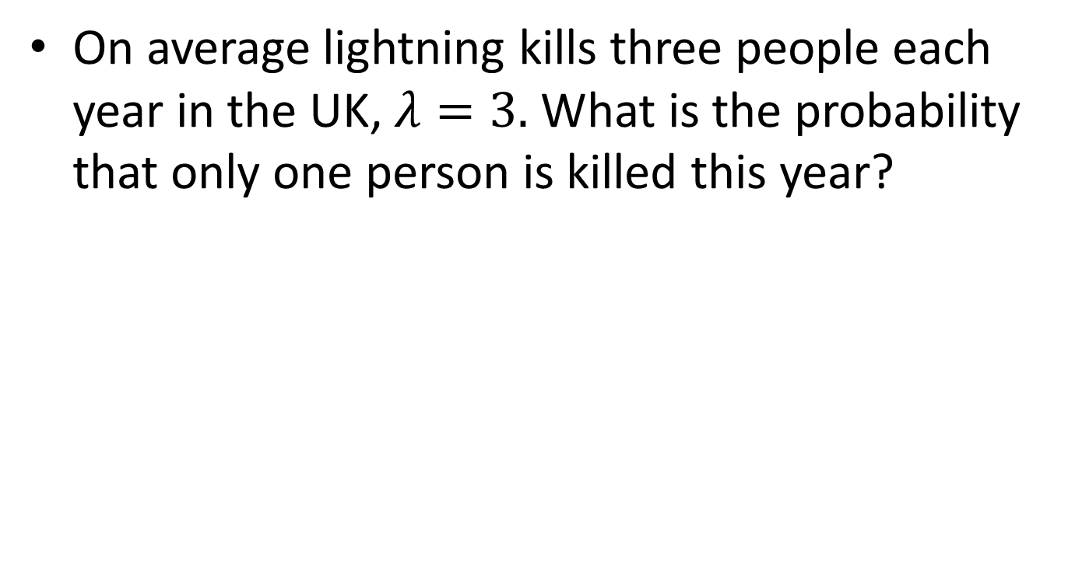
Example 2
On average lightning kills three people each year in the UK, $λ=3.$ What is the probability that only one person is killed this year?

Slide 17
Example 3
Messages arrive at a switching centre at random and at an average rate of 1.2 per second.
Find the probability of 5 messages arriving in a 2-sec interval.
For how long can the operation of the centre be interrupted, if the probability of losing one or more messages is to be no more than 0.05?

Slide 18
Example 4
The probability of a certain part failing within ten years is 10⁻⁶. Five million of the parts have been sold so far.
What is the probability that three or more will fail within ten years?

Slide 19
Example 5
Suppose that a rare disease has an incidence of 1 in 1000 person-years. Assuming that members of the population are affected independently, find the probability of k cases in a population of 10,000 (followed over 1 year) for k=0,1,2

Slide 20
Example 6
if new cases of West Nile in New England are occurring at a rate of about 2 per month, then what’s the probability that exactly 4 cases will occur in the next 3 months?
Exactly 6 cases?

Slide 21
Example 7
If calls to your cell phone are a Poisson process with a constant rate λ=2 calls per hour, what’s the probability that, if you forget to turn your phone off in a 1.5 hour movie, your phone rings during that time?
How many phone calls do you expect to get during the movie?

